Slide 1


Major Projects
Starting our journey

Slide 2
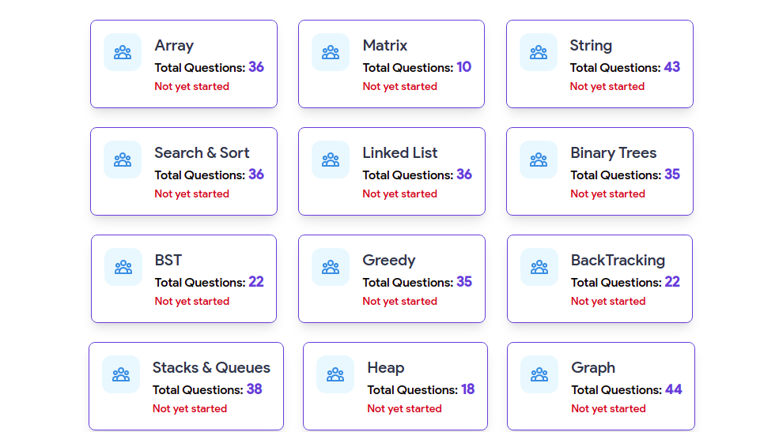
First Project
DSA Tracker

Slide 3


Abstract
Introduction
Tip: Use links to go to a different page inside your presentation. Links work best for pages like this one!
How: Highlight text, click on the link symbol on the toolbar, and select the page in your presentation that you want to connect.
Literature Review
Kindly delete this note after editing this page. Thank you!
Proposed Methodology
Agenda
Software and Hardware Requirements
Tesiting Tools
Tantative Date of Beta version Submission.
Conclusion

Slide 4
Abstract
Problem Statement:- Lack of consistency and motivation in daily DSA practice hampers skill development and career advancement.
Develop a web-based DSA progress tracker to boost consistency.
Utilize daily email notifications with motivation for goal-driven learning.

Slide 5
Introduction
This project aims to enhance DSA learning by creating a web tool that tracks progress, provides motivation, and fosters consistency.

Slide 6
Literature Review
The project addresses a crucial need identified in the literature: the challenge of maintaining consistent progress in Data Structure and Algorithm (DSA) learning. Existing research highlights the significance of regular practice for skill development and career advancement in fields like software engineering and data science. This project seeks to bridge the gap by offering a user-friendly web platform that tracks daily DSA practice, sends reminders, and delivers motivational content, thereby empowering individuals to overcome the consistency barrier and achieve their DSA proficiency and career goals.

Slide 7
Features
User Registration/Login.
Daily Progress Tracking.
Automated Email Reminders.
Motivational Quotes.
Minimalistic UI.
Individualized Tracking facility.

Slide 8
Proposed Methodology
Identified the common struggle of individuals in maintaining consistency and motivation in daily DSA practice.
The project's uniqueness lies in its integration of personalized goal setting, daily progress tracking, automated email reminders, and motivational quotes, filling the gaps in existing solutions and providing a comprehensive approach to DSA skill development and consistency.

Slide 9
Hardware Requirements
Browser
Server
API
Web Hosting
Processor :- Dual Core Pentium II (minimum)
RAM :- 1GB
Storage :- 10GB Free Storage.

Slide 10
Software Requirements
React JS. (for Frontend)
Context API and Redux.
Javascript.
IndexedDB (for database).
Material UI
Chrome or any other browser with a good internet connection.

Slide 11
Conclusion
In summary, our project tackles the consistency challenge in DSA practice.
Individualized tracking, daily email reminders, and motivational content are key features.
Empowers users to attain their DSA proficiency and career goals.

Slide 12
Thank You
Team Members:-
Ayushh Khare (Lead)
Anurag Mishra
Bhavishya Upadhyaya
Abhishek Tripathi

Slide 13
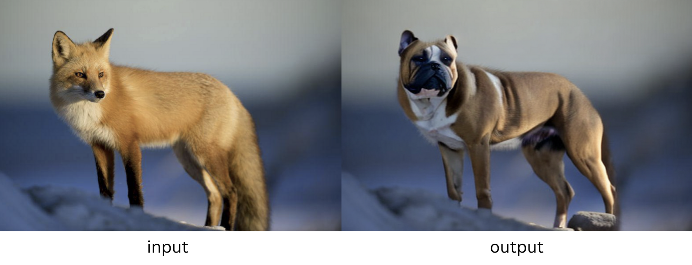
Second Project
Generative AI Solution for Stable Diffusion Inpainting

Slide 14
Abstract
Introduction
Tip: Use links to go to a different page inside your presentation. Links work best for pages like this one!
How: Highlight text, click on the link symbol on the toolbar, and select the page in your presentation that you want to connect.
Literature Review
Kindly delete this note after editing this page. Thank you!
Proposed Methodology
Agenda
Software and Hardware Requirements
Tesiting Tools
Tantative Date of Beta version Submission.
Conclusion

Slide 15
Abstract
Problem Statement:- Enhancing image editing efficiency and realism by integrating Generative AI into Stable Diffusion Inpainting workflows
Utilizing Generative AI and Stable Diffusion to create highly realistic and efficient image inpainting solutions.
It seamlessly integrates Stable Diffusion Inpainting, creating visually coherent and realistic modified images.

Slide 16
Introduction
Introducing our project, focused on harnessing the power of Generative AI within Stable Diffusion Inpainting. We aim to revolutionize image editing, offering efficient, realistic, and cost-effective solutions with broad applicability across industries.

Slide 17
Literature Review
The literature on image inpainting underscores the growing need for efficient and realistic solutions. Conventional methods often struggle with maintaining visual coherence. Recent advancements in Generative AI, particularly Stable Diffusion Inpainting, have shown promise in addressing these challenges. These technologies promise accelerated editing, reduced costs, and an improved user experience. However, a comprehensive understanding of their integration and practical implications within diverse industries is crucial to fully harness their potential. This review sets the stage for our project by highlighting the existing gaps and opportunities in this evolving field.

Slide 18
Features
Generative AI Integration
Stable Diffusion Inpainting.
SAM Predictor
Cost Reduction.
Efficiency.

Slide 19
Proposed Methodology
We propose a solution that combines Generative AI, Stable Diffusion Inpainting, CUDA GPU acceleration, and SAM Predictor.
The process involves masking images using SAM Predictor and using Stable Diffusion Inpainting for precise and realistic inpainting.
Our solution improves image editing workflows by automating and enhancing the efficiency of inpainting.

Slide 20
Hardware Requirements
GPU (Graphics Processing Unit)
Processor:- An Intel Core i7 or higher (or equivalent AMD processor)
RAM :- At least 16GB of RAM is recommended
Storage :- SSD storage for fast data access.
A stable internet connection

Slide 21
Software Requirements
Python.
Operating System
Deep Learning Frameworks.
Python Libraries.
Version Control.

Slide 22
Conclusion
Our Generative AI solution for Stable Diffusion inpainting redefines image editing and content creation.
It seamlessly integrates Stable Diffusion Inpainting, GPU acceleration, and SAM Predictor for efficient editing.
Benefits encompass accelerated editing, cost reduction, enhanced asset utilization, and reduced errors.
The solution caters to diverse industries, including marketing, entertainment, and e-commerce.

Slide 23
Thank You
Team Members:-
Ayushh Khare (Lead)
Anurag Mishra
Bhavishya Upadhyaya
Abhishek Tripathi

Slide 24
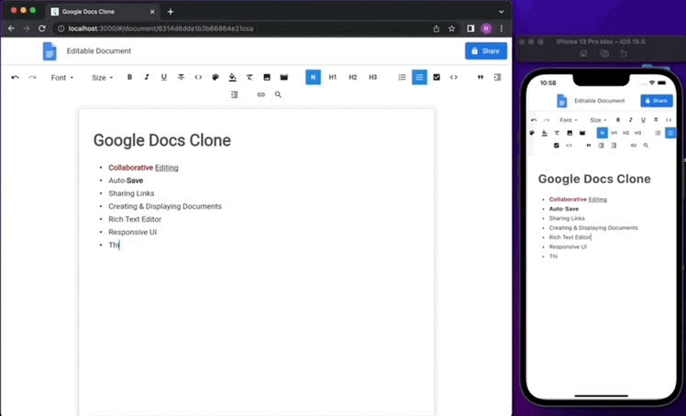
Third Project
Real-Time Collaborative Document Editing Platform

Slide 25
Abstract
Introduction
Tip: Use links to go to a different page inside your presentation. Links work best for pages like this one!
How: Highlight text, click on the link symbol on the toolbar, and select the page in your presentation that you want to connect.
Literature Review
Kindly delete this note after editing this page. Thank you!
Proposed Methodology
Agenda
Software and Hardware Requirements
Tesiting Tools
Tantative Date of Beta version Submission.
Conclusion

Slide 26
Abstract
Problem Statement:- Create a web platform for real-time collaboration, merging rich-text documentation and code editing, targeting both writers and developers, with version control and code execution.
Create a web app for real-time collaborative documentation and code editing, serving writers and developers.
Key features include version control, code execution, and customization, enhancing knowledge sharing and collaboration.

Slide 27
Introduction
In the digital era, the demand for a unified platform that seamlessly combines collaborative documentation and code editing has grown. This project aims to address this need by developing a versatile web application for real-time collaboration, benefiting both technical writers and developers.

Slide 28
Literature Review
Existing document editing and code collaboration tools have primarily focused on either rich-text documentation or code development. While Google Docs and Microsoft Word cater to writers, code-sharing platforms like GitHub serve developers. Bridging this gap, the proposed project aims to integrate both aspects into a single platform, ensuring real-time collaboration, version control, and code execution within documents. This innovative approach aligns with the evolving needs of knowledge-sharing communities and organizations, offering a holistic solution for diverse user groups, from technical writers to software developers.

Slide 29
Features
Real-Time Collaboration
Version Control.
Customization.
User-Friendly Interface.
Efficiency.
Rich Media Integration.
Cross-Platform Compatibility.

Slide 30
Proposed Methodology
Thoroughly analyze user needs and project prerequisites, outlining key features and technical specs.
Employ an agile development model, subdividing tasks into sprints, and incorporating user feedback for ongoing improvements.
Utilize React, Node.js, MongoDB, Socket.io, and Quill.js, following industry best practices for web development.

Slide 31
Hardware Requirements
Processor:- A multi-core processor
RAM:- 8 GB RAM or more is a good
Storage:- SSD storage for fast data access.
A stable internet connection
MongoDB as the database

Slide 32
Software Requirements
ReactJS
Quill.js and Socket.io(for real-time communication).
Node.js.
MongoDB as a database system.
Version Control.
Deployment and Hosting.

Slide 33
Conclusion
A unified platform for writers and developers.
Seamless real-time collaboration and version control.
User-friendly, customizable, and scalable.
Addresses diverse needs for knowledge sharing.
Employs modern technology stack and agile approach.
An adaptable solution for collaborative content and code sharing.

Slide 34
Thank You
Team Members:-
Ayushh Khare (Lead)
Anurag Mishra
Bhavishya Upadhyaya
Abhishek Tripathi

